Slide 1
Analysis of Algorithms
Input
Algorithm
Output
© 2010 Goodrich, Tamassia
Analysis of Algorithms

Slide 2

Running Time
Most algorithms transform input objects into output objects.
The running time of an algorithm typically grows with the input size.
Average case time is often difficult to determine.
We focus on the worst case running time.
  Easier to analyze
  Crucial to applications such as games, finance and robotics
© 2010 Goodrich, Tamassia
Analysis of Algorithms

Slide 3

Experimental Studies
Write a program implementing the algorithm
Run the program with inputs of varying size and composition
Use a method like clock() to get an accurate measure of the actual running time
Plot the results
© 2010 Goodrich, Tamassia
Analysis of Algorithms

Slide 4

Limitations of Experiments
It is necessary to implement the algorithm, which may be difficult
Results may not be indicative of the running time on other inputs not included in the experiment.
In order to compare two algorithms, the same hardware and software environments must be used
© 2010 Goodrich, Tamassia
Analysis of Algorithms

Slide 5

Theoretical Analysis
Uses a high-level description of the algorithm instead of an implementation
Characterizes running time as a function of the input size, n.
Takes into account all possible inputs
Allows us to evaluate the speed of an algorithm independent of the hardware/software environment
© 2010 Goodrich, Tamassia
Analysis of Algorithms

Slide 6
Pseudocode
Example: find max element of an array
High-level description of an algorithm
More structured than English prose
Less detailed than a program
Preferred notation for describing algorithms
Hides program design issues
Algorithm arrayMax(A, n)
Input array A of n integers
Output maximum element of A
currentMax ← A[0]
for i ← 1 to n − 1 do
if A[i] > currentMax then
currentMax ← A[i]
return currentMax
© 2010 Goodrich, Tamassia
Analysis of Algorithms

Slide 7
Pseudocode Details
Control flow
  if … then … [else …]
  while … do …
  repeat … until …
  for … do …
  Indentation replaces braces
Method declaration
  Algorithm method (arg [, arg…])
  Input …
  Output …
Method call
  var.method (arg [, arg…])
Return value
  return expression
Expressions
  Assignment
  (like = in C++)
  Equality testing
  (like == in C++)
  n² Superscripts and other mathematical formatting allowed
© 2010 Goodrich, Tamassia
Analysis of Algorithms

Slide 8
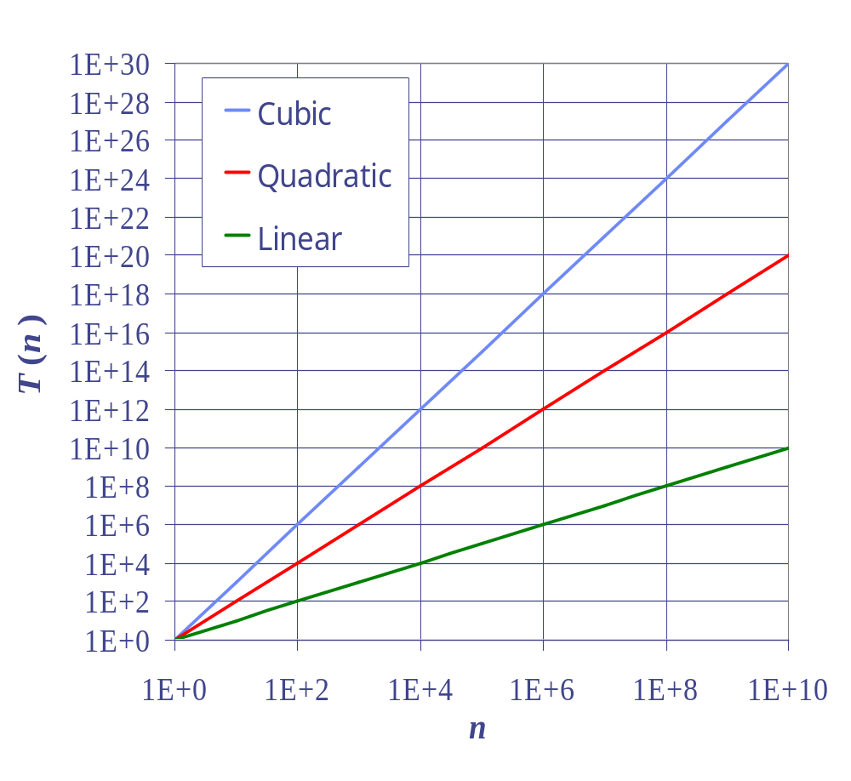
Seven Important Functions
Seven functions that often appear in algorithm analysis:
  Constant ≈ 1
  Logarithmic ≈ log n
  Linear ≈ n
  N-Log-N ≈ n log n
  Quadratic ≈ n²
  Cubic ≈ n³
  Exponential ≈ 2^{n}
In a log-log chart, the slope of the line corresponds to the growth rate
© 2010 Goodrich, Tamassia
Analysis of Algorithms

Slide 9
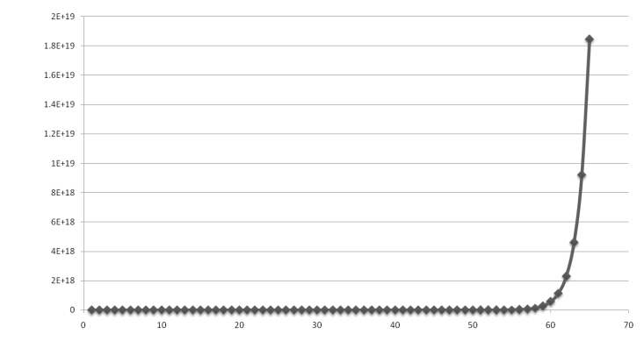
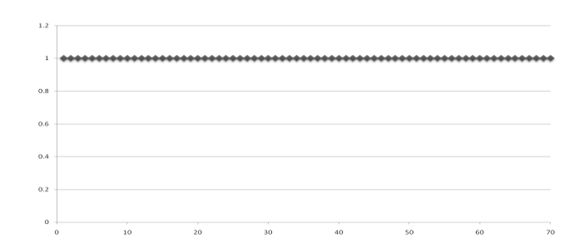
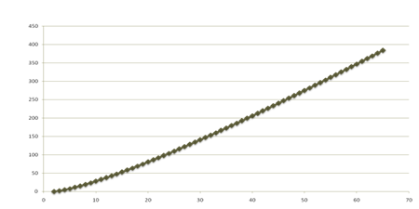
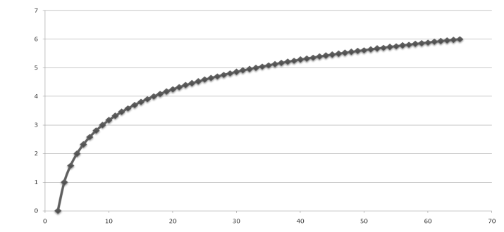
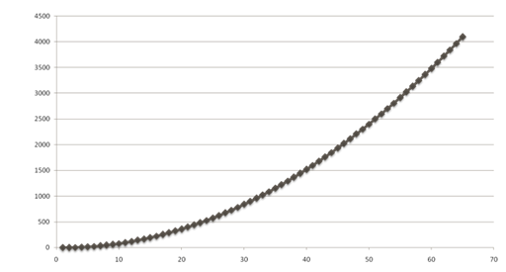
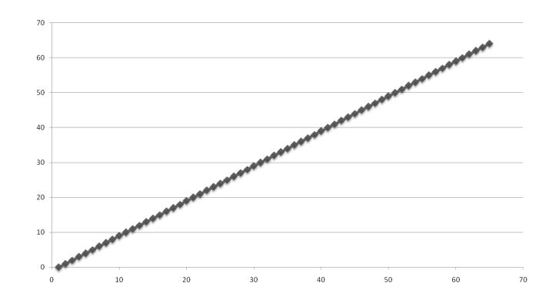
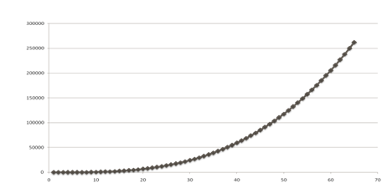
Functions Graphed
Using “Normal” Scale
Slide by Matt Stallmann included with permission.
g(n) = n lg n
g(n) = 1
g(n) = 2^{n}
g(n) = n²
g(n) = lg n
g(n) = n
g(n) = n³
© 2010 Stallmann
Analysis of Algorithms

Slide 10

Primitive Operations
Basic computations performed by an algorithm
Identifiable in pseudocode
Largely independent from the programming language
Exact definition not important (we will see why later)
Assumed to take a constant amount of time in the RAM model
Examples:
  Evaluating an expression
  Assigning a value to a variable
  Indexing into an array
  Calling a method
  Returning from a method
© 2010 Goodrich, Tamassia
Analysis of Algorithms

Slide 11
Counting Primitive Operations
By inspecting the pseudocode, we can determine the maximum number of primitive operations executed by an algorithm, as a function of the input size
Algorithm arrayMax(A, n)
# operations
currentMax ← A[0] 2
for i ← 1 to n − 1 do 2n
if A[i] > currentMax then 2(n − 1)
currentMax ← A[i] 2(n − 1)
{ increment counter i } 2(n − 1)
return currentMax 1
Total 8n − 2
© 2010 Goodrich, Tamassia
Analysis of Algorithms

Slide 12

Estimating Running Time
Algorithm arrayMax executes 8n − 2 primitive operations in the worst case. Define:
  a = Time taken by the fastest primitive operation
  b = Time taken by the slowest primitive operation
Let T(n) be worst-case time of arrayMax. Then
a (8n − 2) ≤ T(n) ≤ b(8n − 2)
Hence, the running time T(n) is bounded by two linear functions
© 2010 Goodrich, Tamassia
Analysis of Algorithms

Slide 13

Growth Rate of Running Time
Changing the hardware/ software environment
  Affects T(n) by a constant factor, but
  Does not alter the growth rate of T(n)
The linear growth rate of the running time T(n) is an intrinsic property of algorithm arrayMax
© 2010 Goodrich, Tamassia
Analysis of Algorithms

Slide 14
Why Growth Rate Matters
Slide by Matt Stallmann included with permission.
if runtime is... | time for n + 1 | time for 2 n | time for 4 n
c lg n | c lg (n + 1) | c (lg n + 1) | c(lg n + 2)
c n | c (n + 1) | 2c n | 4c n
c n lg n | ~ c n lg n + c n | 2c n lg n + 2cn | 4c n lg n + 4cn
c n² | ~ c n² + 2c n | 4c n² | 16c n²
c n³ | ~ c n³ + 3c n² | 8c n³ | 64c n³
c 2^{n} | c 2 ^{n+1} | c 2 ^{2n} | c 2 ^{4n}
runtime
quadruples
when problem
size doubles
© 2010 Stallmann
Analysis of Algorithms

Slide 15
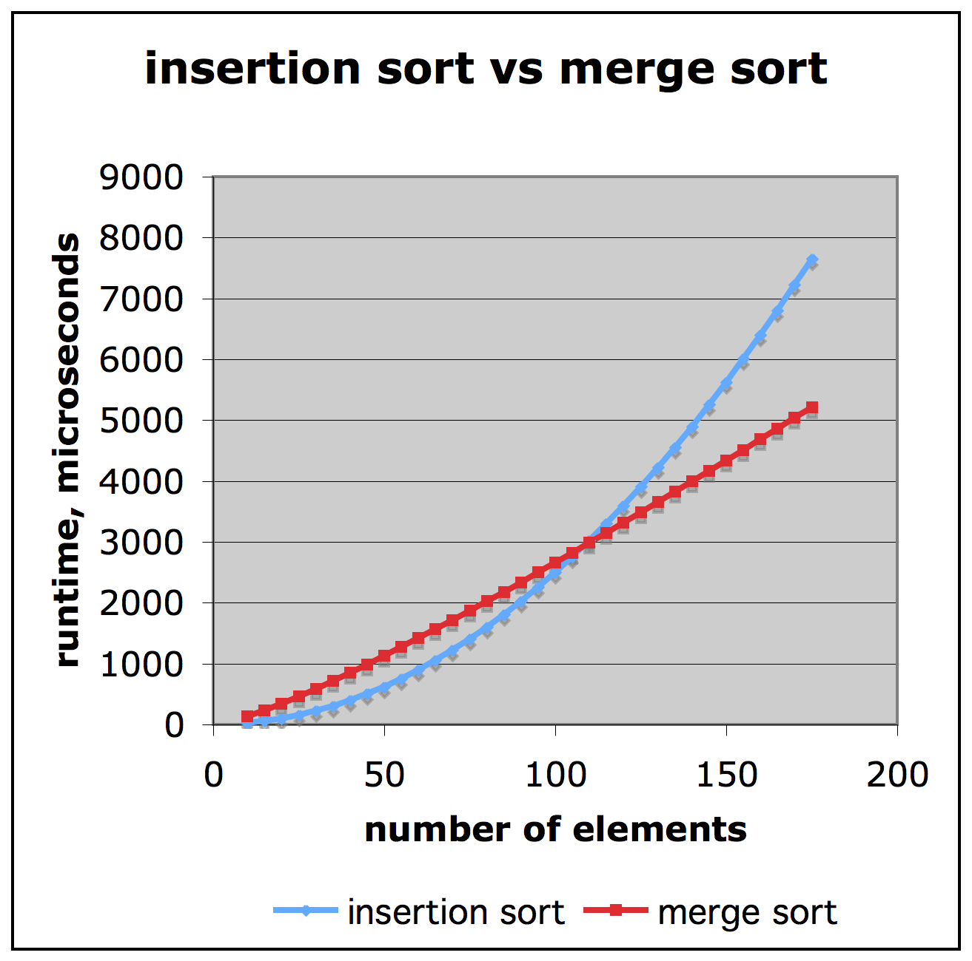
Comparison of Two Algorithms
Slide by Matt Stallmann included with permission.
insertion sort is
n² / 4
merge sort is
2 n lg n
sort a million items?
insertion sort takes
roughly 70 hours
while
merge sort takes
roughly 40 seconds
This is a slow machine, but if
100 x as fast then it’s 40 minutes
versus less than 0.5 seconds
© 2010 Stallmann
Analysis of Algorithms

Slide 16
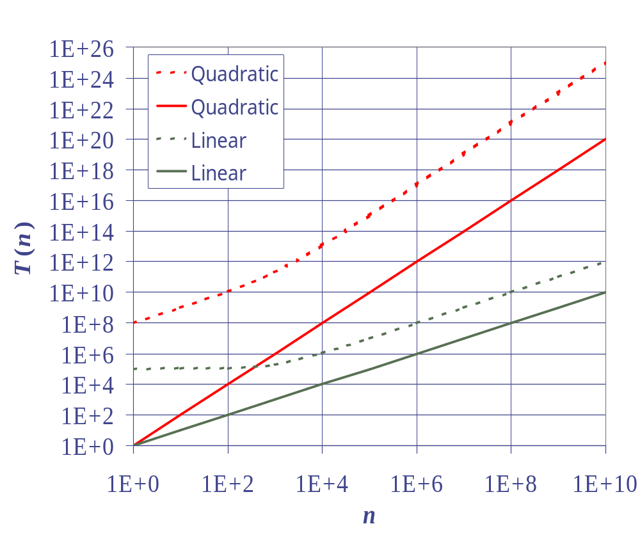
Constant Factors
The growth rate is not affected by
  constant factors or
  lower-order terms
Examples
  10²n + 10⁵ is a linear function
  10⁵n² + 10⁸n is a quadratic function
© 2010 Goodrich, Tamassia
Analysis of Algorithms

Slide 17


More Big-Oh Examples
7n-2
  7n-2 is O(n)
3n³ + 20n² + 5
  3n³ + 20n² + 5 is O(n³)
3 log n + 5
  3 log n + 5 is O(log n)
© 2010 Goodrich, Tamassia
Analysis of Algorithms

Slide 18

Big-Oh Rules
If is f(n) a polynomial of degree d, then f(n) is O(n^{d}), i.e.,
  Drop lower-order terms
  Drop constant factors
Use the smallest possible class of functions
  Say “2n is O(n)” instead of “2n is O(n²)”
Use the simplest expression of the class
  Say “3n + 5 is O(n)” instead of “3n + 5 is O(3n)”
© 2010 Goodrich, Tamassia
Analysis of Algorithms

Slide 19
Asymptotic Algorithm Analysis
The asymptotic analysis of an algorithm determines the running time in big-Oh notation
To perform the asymptotic analysis
  We find the worst-case number of primitive operations executed as a function of the input size
  We express this function with big-Oh notation
Example:
  We determine that algorithm arrayMax executes at most 8n − 2 primitive operations
  We say that algorithm arrayMax “runs in O(n) time”
Since constant factors and lower-order terms are eventually dropped anyhow, we can disregard them when counting primitive operations
© 2010 Goodrich, Tamassia
Analysis of Algorithms

Slide 20

Computing Prefix Averages
We further illustrate asymptotic analysis with two algorithms for prefix averages
The i-th prefix average of an array X is average of the first (i + 1) elements of X:
A[i] = (X[0] + X[1] + … + X[i])/(i+1)
Computing the array A of prefix averages of another array X has applications to financial analysis
© 2010 Goodrich, Tamassia
Analysis of Algorithms

Slide 21
Prefix Averages (Quadratic)
The following algorithm computes prefix averages in quadratic time by applying the definition
Algorithm prefixAverages1(X, n)
Input array X of n integers
Output array A of prefix averages of X #operations
A ← new array of n integers n
for i ← 0 to n − 1 do n
s ← X[0] n
for j ← 1 to i do 1 + 2 + …+ (n − 1)
s ← s + X[j] 1 + 2 + …+ (n − 1)
A[i] ← s / (i + 1) n
return A 1
© 2010 Goodrich, Tamassia
Analysis of Algorithms

Slide 22
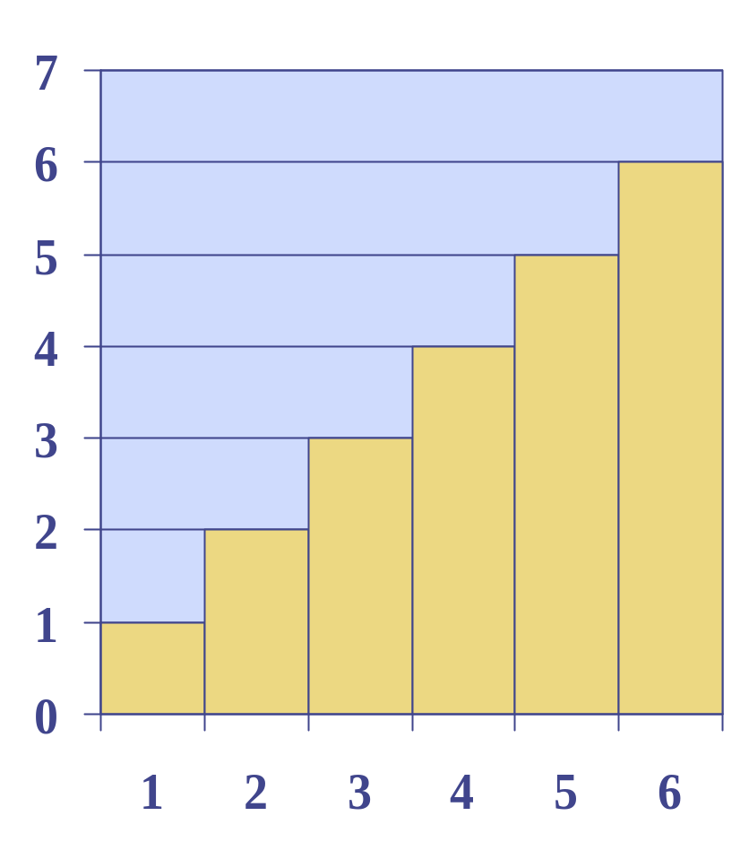
Arithmetic Progression
The running time of prefixAverages1 is
O(1 + 2 + …+ n)
The sum of the first n integers is n(n + 1) / 2
  There is a simple visual proof of this fact
Thus, algorithm prefixAverages1 runs in O(n²) time
© 2010 Goodrich, Tamassia
Analysis of Algorithms

Slide 23
Prefix Averages (Linear)
The following algorithm computes prefix averages in linear time by keeping a running sum
Algorithm prefixAverages2(X, n)
Input array X of n integers
Output array A of prefix averages of X #operations
A ← new array of n integers n
s ← 0 1
for i ← 0 to n − 1 do n
s ← s + X[i] n
A[i] ← s / (i + 1) n
return A 1
Algorithm prefixAverages2 runs in O(n) time
© 2010 Goodrich, Tamassia
Analysis of Algorithms

